Slide 1
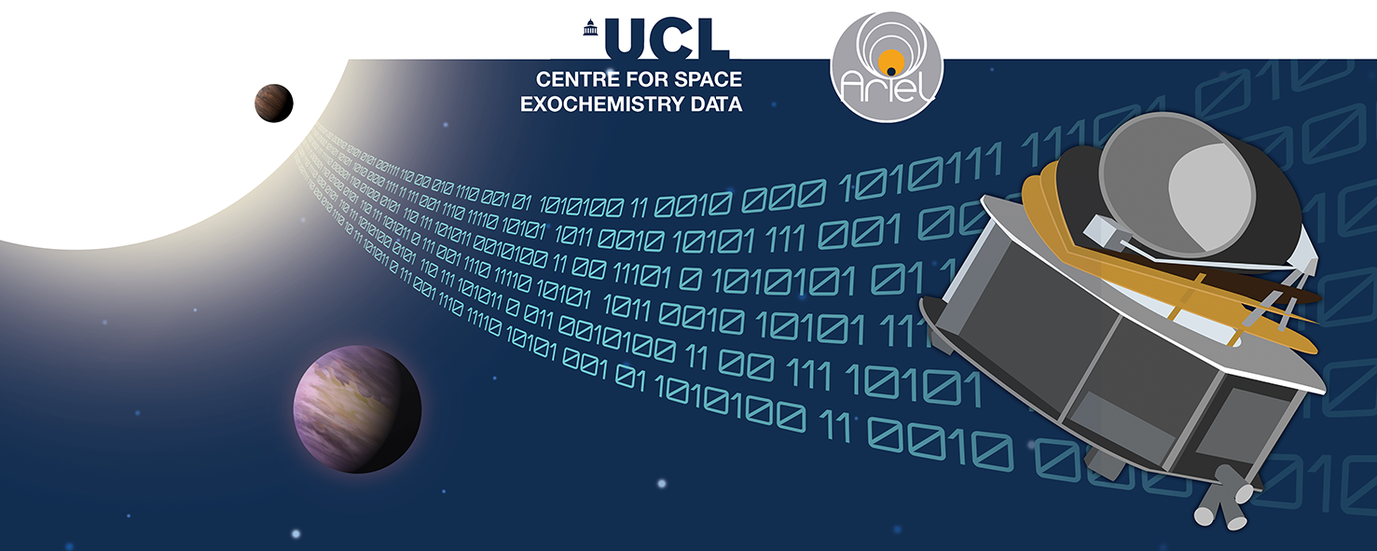
Lecture 1: Introduction to Ariel Data Challenge 2024
Tutorials: NeurIPS - Ariel Data Challenge 2024
Presenter: kaggle君-sakura（bili_sakura@zju.edu.cn）
Date: October 8, 2024
Image Credit: NeurIPS - Ariel Data Challenge 2024 | Kaggle
© kaggle君-sakura, 2024. All rights reserved.

Slide 2
Outline
Background
Data Overview
Research Objective & Evaluation Metrics
Introduction to Regression/Prediction Task
Quick Start on Kaggle for Submission
© kaggle君-sakura, 2024. All rights reserved.

Slide 3
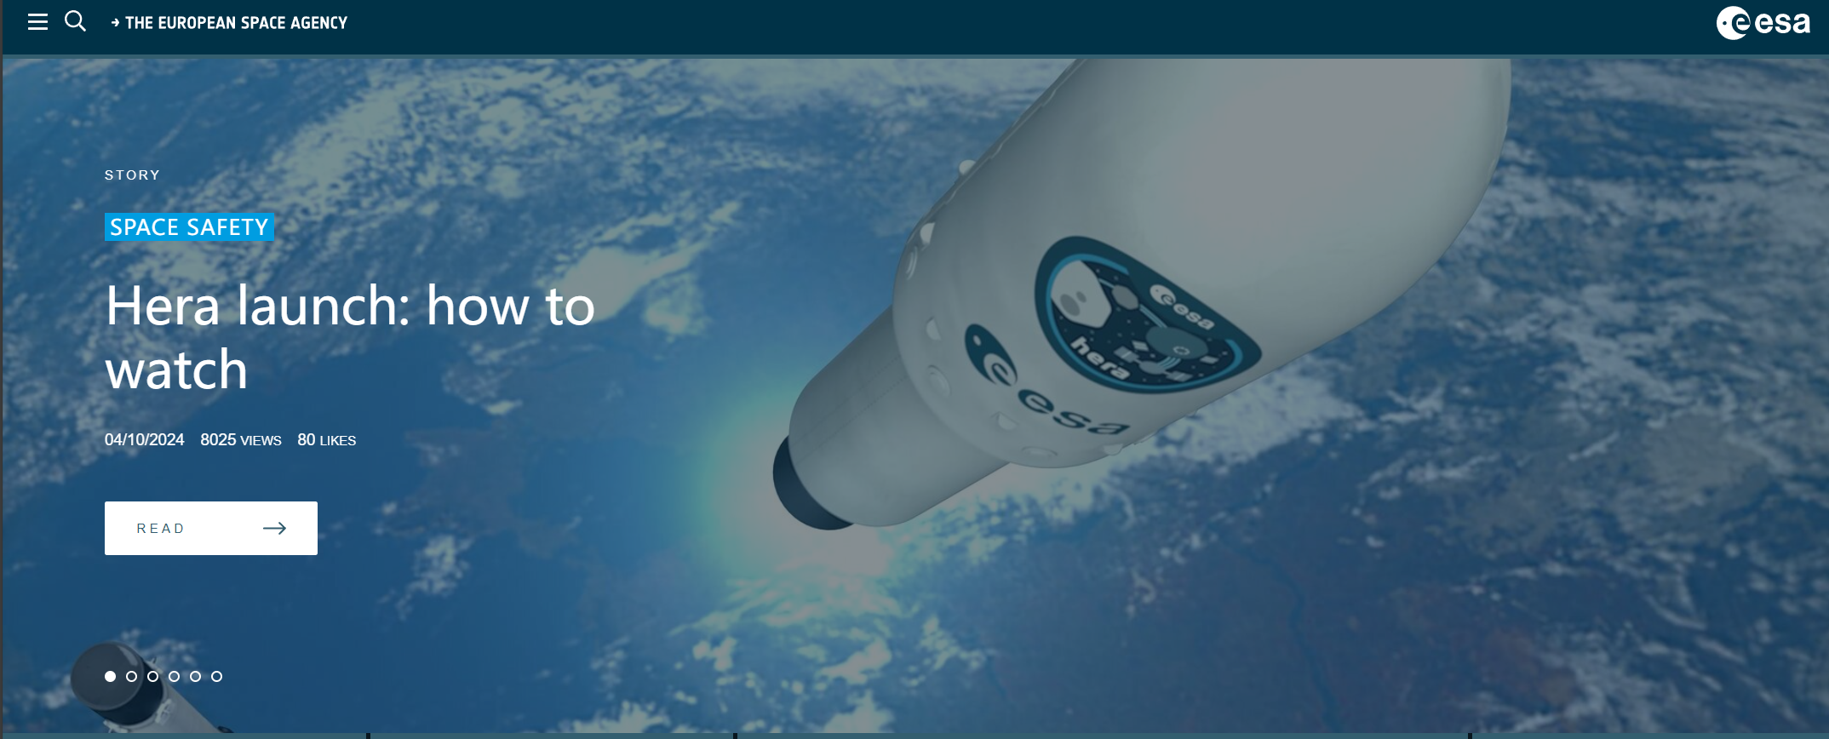
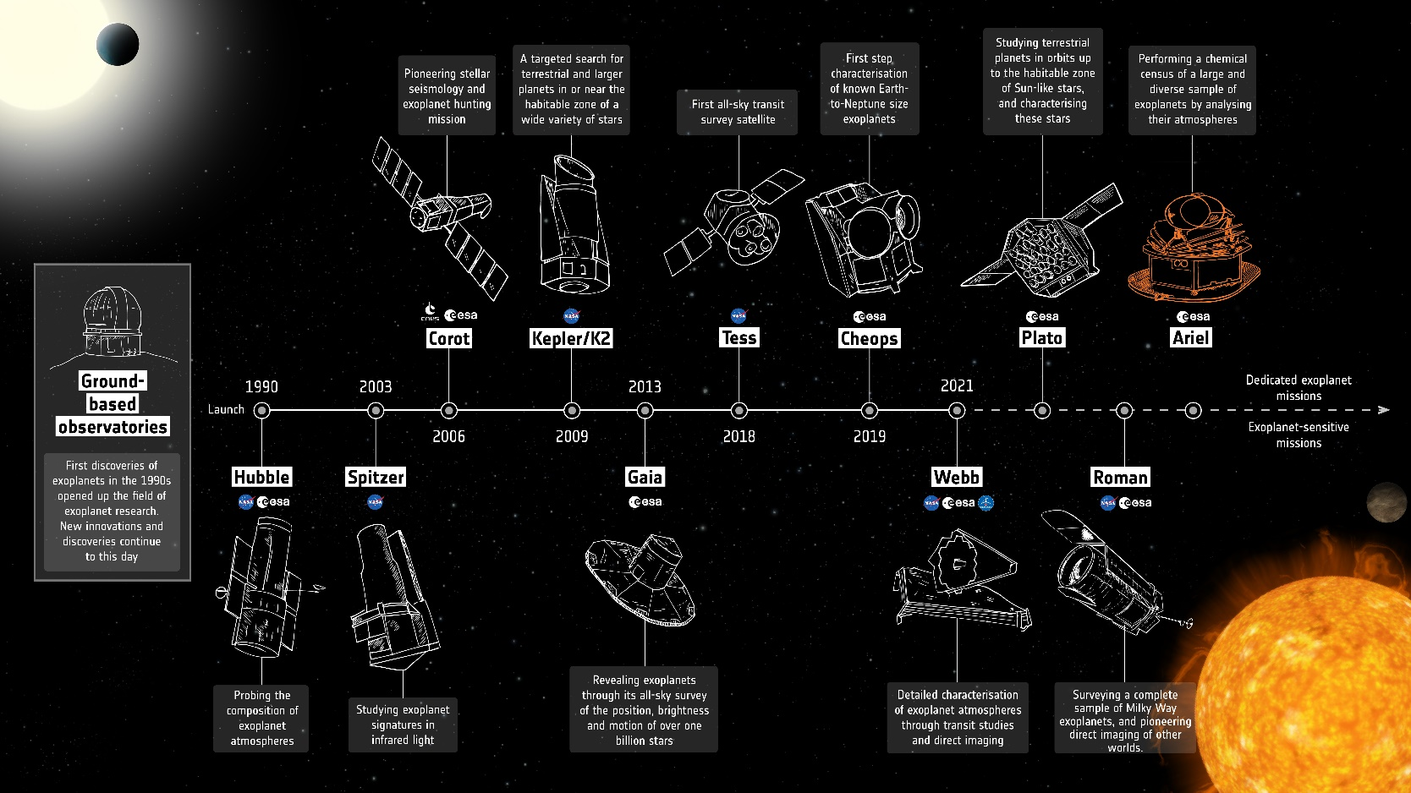

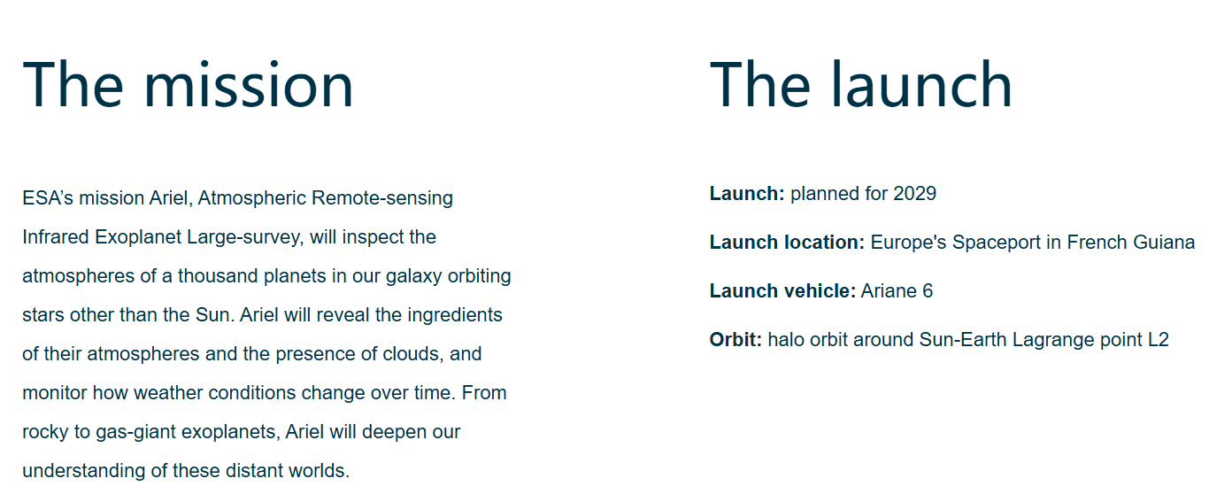
Background
European Space Agency's Ariel Mission: Atmospheres of ~1,000 exoplanets
European Space Agency
Exoplanet mission timeline - Ariel
ESA - Ariel Mission
© kaggle君-sakura, 2024. All rights reserved.

Slide 4
Background
The background of the Ariel Data Challenge 2024 is rooted in the European Space Agency's Ariel Mission, which aims to study the atmospheres of roughly 1,000 exoplanets. The mission will analyze the chemical composition of these distant worlds by observing them as they transit their host stars. These observations will be done using powerful instruments that collect limited amounts of light (photons), which are further complicated by significant noise due to spacecraft vibrations and other factors.
The primary challenge for the project is to extract faint exoplanetary signals from the noisy data, particularly focusing on the spectral data that reveals atmospheric composition. Participants are tasked with designing machine learning models that can process time series data from two instruments onboard the Ariel satellite (FGS1 and AIRS-CH0), apply noise reduction techniques, and accurately extract the atmospheric spectra along with their uncertainties.
This project is significant because it directly contributes to the growing field of exoplanet research, helping scientists understand the chemical makeup of planets outside our solar system. Ariel is expected to launch in 2029, but this simulated data provides an opportunity to develop tools and methods well in advance.
Ariel数据挑战赛2024的背景基于欧洲航天局的Ariel任务，该任务旨在研究大约1000颗系外行星的大气层。该任务通过观察这些行星经过其宿主恒星时的凌日现象来分析这些遥远星球的化学成分。这些观测将利用强大的仪器收集有限数量的光子（光），但数据中会夹杂大量噪声，特别是由于航天器振动等因素产生的抖动噪声。
项目的主要挑战是从噪声数据中提取微弱的系外行星信号，特别是关注揭示大气成分的光谱数据。参与者需要设计机器学习模型，处理来自Ariel卫星上两种仪器（FGS1和AIRS-CH0）的时间序列数据，应用降噪技术，并准确提取大气光谱及其不确定性。
这个项目非常重要，因为它直接推动了系外行星研究的发展，帮助科学家了解太阳系外行星的化学组成。虽然Ariel计划在2029年发射，但这些模拟数据提供了提前开发工具和方法的机会。
© kaggle君-sakura, 2024. All rights reserved.

Slide 5
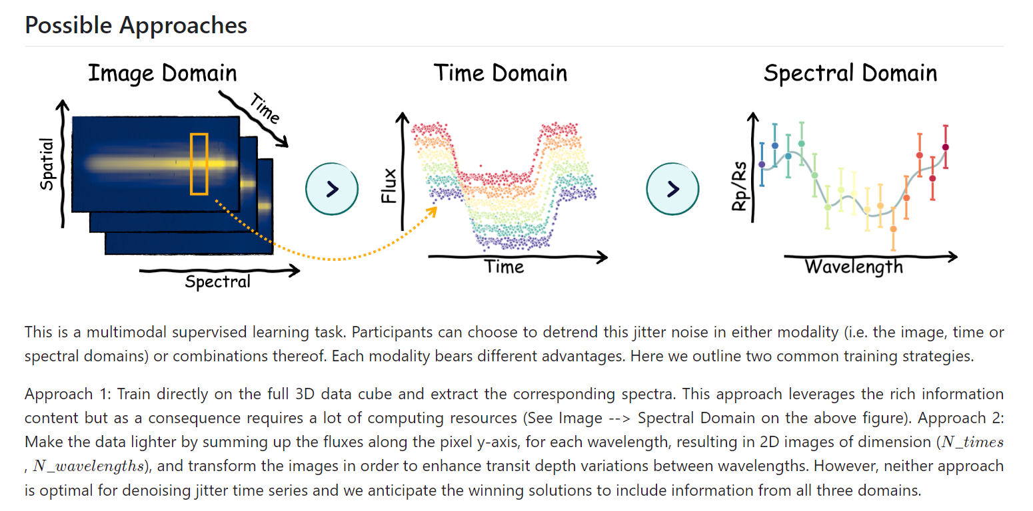
Data
Let’s just ignore processing it into other format currently.
Signal Data Visualization
© kaggle君-sakura, 2024. All rights reserved.

Slide 6
Data – Signal Files
AIRS-CH0_signal.parquet: 11,250 frames (time), 32 × 356 (spatial × spectral)
FGS1_signal.parquet: 135,000 frames (time), 32 × 32 (spatial × spectral)
Note: *.parquet file is a compressed file which can be easily convert into numpy array/ tensor. Also, you should reshape it into 3-d data in this case.
For simplicity, suggested by official documentation, you can convert 3D data into 2D/1D by averaging the spatial dimension.
© kaggle君-sakura, 2024. All rights reserved.

Slide 7
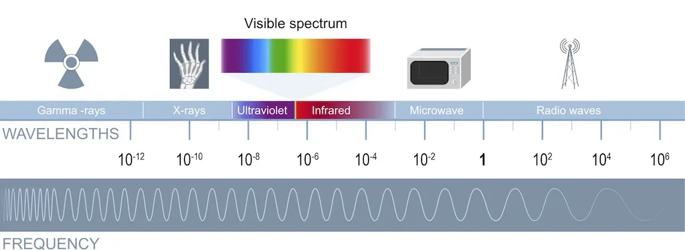

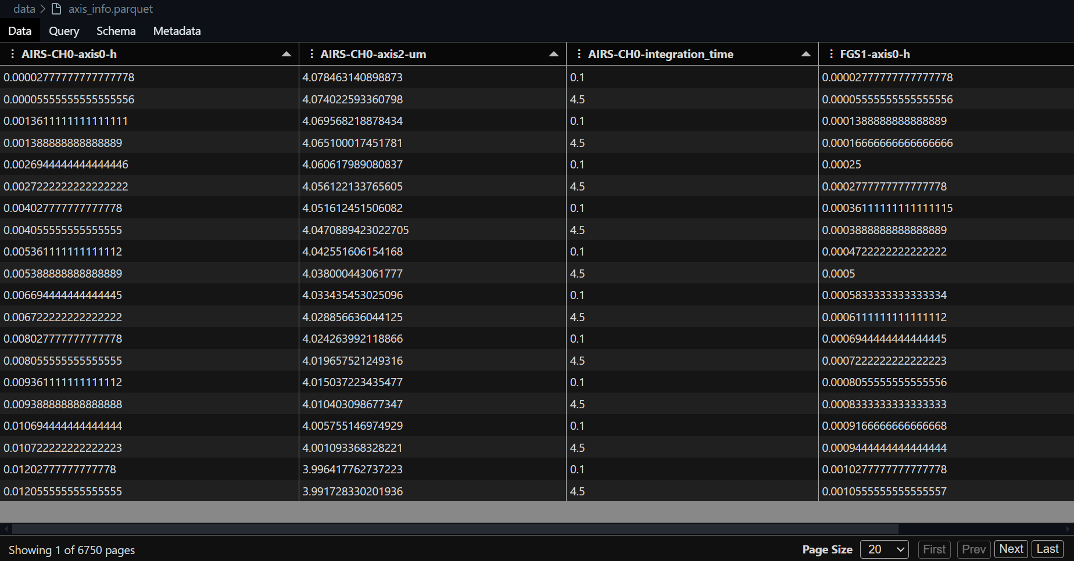
Data – Metadata Files
…
Left: wavelengths.csv, the value denote the wavelength in µm for this column.
Right: The electromagnetic spectrum, from highest to lowest frequency wavelengths. (Image credit: Shutterstock)
FGS1 is the first channel of Ariel's Fine Guidance System (FGS). The main task of the Fine Guidance System is to enable centering, focusing, and guiding of the satellite but it will also provide high-precision photometry of the target star in the visible spectrum. It has a sensitivity between 0.60 and 0.80 µm. AIRS-CH0 is the first channel (CH0) of the Ariel InfraRed Spectrometer (AIRS). It is an infrared spectrometer with a sensitivity between 1.95 and 3.90 µm, and has a resolving power of approximately R=100. For more information about Ariel please visit the Ariel red book.
axis_info.parquet: Axis information for both instruments.
Axis information for both instruments (i.e. AIRS-CH0 and FGS).
© kaggle君-sakura, 2024. All rights reserved.

Slide 8
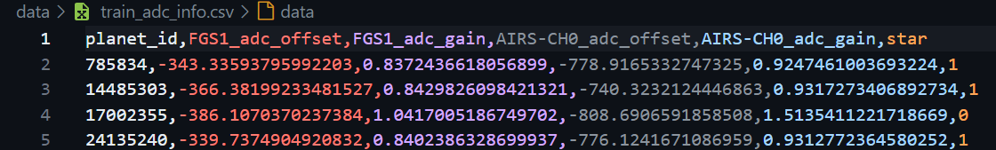
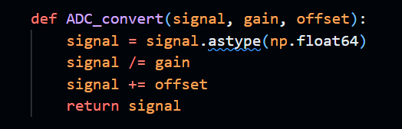
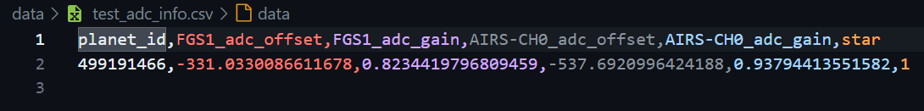
Data – Metadata Files
[train/test]_adc_info.csv: Contains analog-to-digital (ADC) conversion parameters (gain and offset) for restoring the original dynamic range of the data. Also includes a star column identifying which star was used for that planet's simulation.包含模数转换(ADC)参数（增益和偏移），用于恢复原始数据的动态范围。此外，还包含每个行星模拟所用恒星的信息。
A
B
I think “/=“ should be “*=” actually.
C
A: train_adc_info.csv. B: test_adc_info.csv. C: Conversion with gain and offset given from adc_info file.
Note: For detailed calibration steps, refer to official notebook.
© kaggle君-sakura, 2024. All rights reserved.

Slide 9
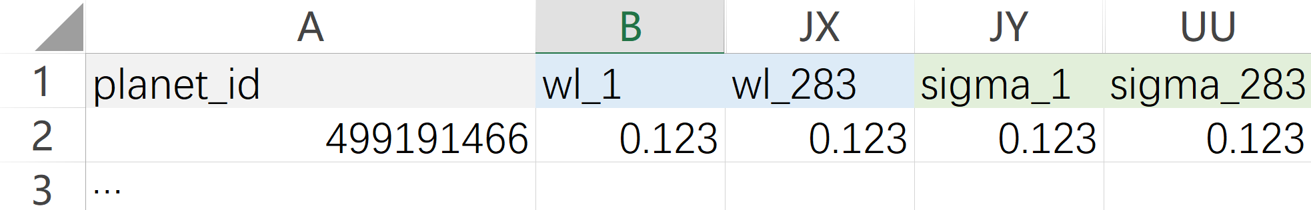
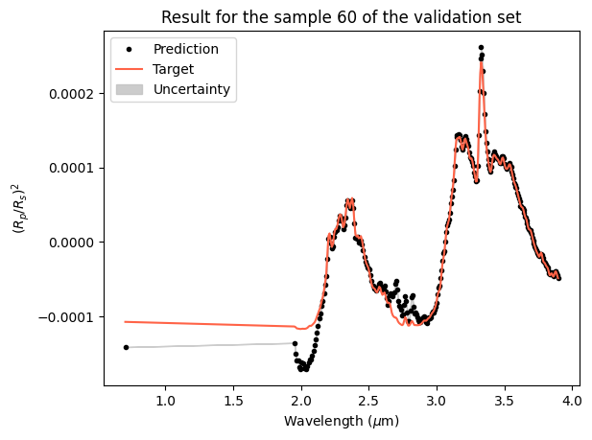
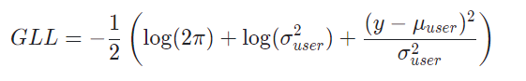
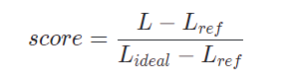
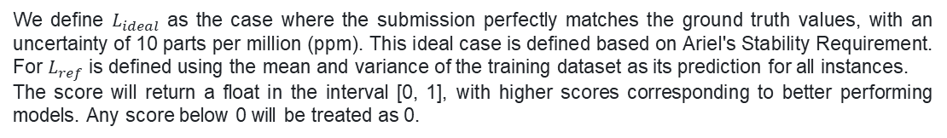
Objective & Metrics
…
…
This is a Regression task!
Evaluated by Gaussian Log-likelihood (GLL) function
We define $L_{ideal}$ as the case where the submission perfectly matches the ground truth values, with an uncertainty of 10 parts per million (ppm). This ideal case is defined based on Ariel's Stability Requirement. For $L_{ref}$ is defined using the mean and variance of the training dataset as its prediction for all instances.
The score will return a float in the interval [0, 1], with higher scores corresponding to better performing models. Any score below 0 will be treated as 0.
Visualization of prediction results from official notebook.
© kaggle君-sakura, 2024. All rights reserved.

Slide 10
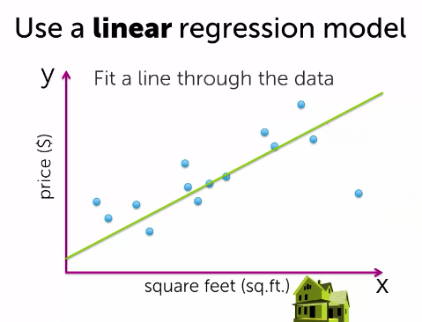
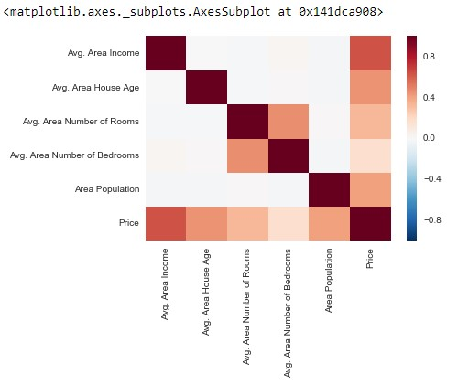
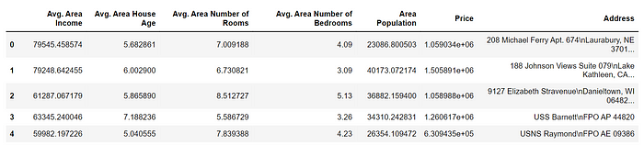
Regression
Consider a housing price estimation task.
https://medium.com/@kaushiksimran827/house-price-prediction-a-simple-guide-with-scikit-learn-and-linear-regression-f91a27b9d650
https://medium.com/@yennhi95zz/2-introduction-to-linear-regression-predicting-house-prices-a36f6172030
© kaggle君-sakura, 2024. All rights reserved.

Slide 11
How to do with Kaggle
Register your Kaggle Account. (recommend to use your edu.cn email)
Join the competition. (Click I accept and feel free.)
Try your first submission. (You can copy others’ work freely from Code panel to give a first try. As they are publicly available, there is no copyright issue, feel free again. ☺)
Let’s go further.
If you want to get a medium score, using simple machine learning algorithm is plausible, so that training is fast. You can do it easily in your kaggle notebook.
If you want to be competitive, there is no way out except considering it as a multimodal task. You are going to training a deep neural network much similar as a traditional convolutional neural network. BUT, as the data is not a normal 2D image with timestamp rather a (time, spectral, y-axis) tuple data, pre-trained vision foundation models would not work! You need train a model based on the given data from scratch with your own designed model architecture (I think 3D convolution module would work.). This leads to a large amount of training compute, it is highly recommended to do your training on your own GPU clusters because kaggle notebook GPU (T4) is not quite good and it is painful to manage your project on cloud.
© kaggle君-sakura, 2024. All rights reserved.

Slide 12
Thanks for listening!

